Slide 1
Status Report: Classification of Bikes using
Feed Forward Networks
Akash Raj K. R. • Akshay N. • 09.04.2020

Slide 2
Submitted to:
Dr. H.C. Vijayalakshmi
Dept. of CS&E

Slide 3
Overview
Implementation of feedforward neural network using Multilayer perceptron (MLP). Multiclass classification is achieved for different classes of bikes dataset given in the form of images.

Slide 4
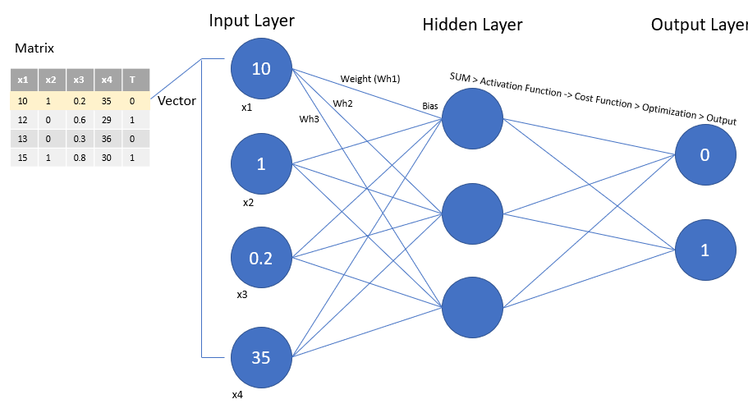
Multilayer perceptron (MLP)

Slide 5
Multiclass perceptron
The multi-class perceptron algorithm is a supervised learning algorithm for classification of data into one of a series of classes.
It is a class of feedforward Artificial Neural Network(ANN).
The feedforward(FF) neural network consists of two or more layers (an input and an output layer with zero or more hidden layers) of nonlinearly-activating nodes. Since FFs are fully connected, each node in one layer connects with a certain weight to every node in the following layer.

Slide 6
Algorithm Summary
The data which is given in the form of an image, is assigned to a class to which it belongs and this pair is fed into the training algorithm. When this feature vector is received by the artificial neuron as a stimulus, it is multiplied (dot product) by a weight vector, to calculate the activation value of the specific data point. If the activation energy is high enough, the neuron fires (the data meets the classification criteria).

Slide 7
Algorithm Summary (Contd.)
In the case of a multi-class classification, the data comes in the same way, but instead of the respecting feature vector being multiplied by a single weight vector (for a single class), it is multiplied (dot product) by a number of weight vectors (a separate vector of weights for each unique class). Whichever weight vector that yields the highest activation energy product is the class the data belongs to (ReLU). This decision process is known as the Multi-Class Decision Rule.

Slide 8
Training process
During each iteration of training, the data (formatted as a input vector) is read in, and the dot product is taken with each unique weight vector (which are all initially set to 0). The class that yields the highest product is the class to which the data belongs. In the case this class is the correct value (matches with the actual category to which the data belongs), nothing happens, and the next data point is read in.

Slide 9
Training process
(contd.)
However, in the case that the predicted value is wrong, the weight vectors are corrected as follows: The feature vector is subtracted from the predicted weight vector, and added to the actual (correct) weight vector.
After the final iteration, the final weight vectors should be somewhat stable (it is of importance to note that unlike the assumptions of the binary perceptron, there is no guarantee the multi-class perceptron will reach a steady state), and the classifier will be ready to be put to use.

Slide 10
Development environment
Programming language: Python3.7
IDE: Pycharm
OS: Ubuntu 16.04 above
Libraries used: random, numpy, opencv-python, tqdm etc.

Slide 11

Input dataset
We have 4 classes of bike images dirt, sports, scooter and chopper. Each class has 25 images making a total of 100 images.

Slide 12
Code Implementation
Formatting the Data
classes = ['sports','dirt','scooter','chopper']
feature_data = [(class, {'path': <actual path to image file>})]
img = cv2.imread(feature_dict['path'])
dim = (30, 30)
resized = cv2.resize(img, dim, cv2.INTER_AREA)
input_array = []
for i in range(resized.shape[0]):
for j in range(resized.shape[1]):
input_array.append((np.mean(resized[i][j]) / 255))
input_array.append(BIAS)
input_vector = np.array(input_array)

Slide 13
Training data
arg_max, predicted_class = 0, self.classes[0]
# Multi-Class Decision Rule:
for c in self.classes:
current_activation = np.dot(input_vector, self.weight_vectors[c])
if current_activation >= arg_max:
arg_max, predicted_class = current_activation, c
# Update Rule:
if not (category == predicted_class):
self.weight_vectors[category] += [i * self.lr for i in input_vector]
self.weight_vectors[predicted_class] -= [i * self.lr for i in input_vector]

Slide 14
Predicting Unseen Data Inputs
def predict(self, feature_dict):
arg_max, predicted_class = 0, self.classes[0]
# Multi-Class Decision Rule:
for c in self.classes:
current_activation = np.dot(feature_vector, self.weight_vectors[c])
if current_activation >= arg_max:
arg_max, predicted_class = current_activation, c
return predicted_class

Slide 15


Output

